Slide 1
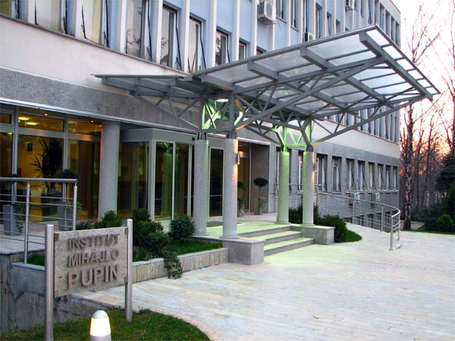
Maxeler @ Pupin Institute
Goran Dimić
goran.dimic@pupin.rs

Slide 2
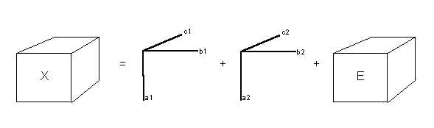
DAFNE WP1.7: PARAFAC, ALS
3-way data tensors: low-rank decomposition
In: X: I x J x K
Out: A: I x F, B: J x F, C: K x F
Identifiability: Unique under mild conditions
Repeat: 1. A(X, B, C); 2. B(X, C, A); 3. C(X, A, B);

Slide 3
DAFNE WP1.7: Data, Applications
Gastronomy: 42.000 x 350 x 24.000 (UCPH)
Metabolomics: 3.600 x 9.500 x 1.600 (UCPH)
Data size: ~1 TB
Resampling: 1.000x (for data statistics) ~1 PB
Fit each sampling: 1.000 – 100.000 iterations
Equivalent data size: ~1+ EB
Incomplete data: fit if up to 90% missing
Applications: (Hyper)graphs, data mining, SP…

